Slide 1
CSPROJ2 – Project Presentation
MI121’s Group 8, RMC-WBOS group

Slide 2
Group 8: RMC-WBOS
Presented by: Carlos Daniel B. Nerez and John Michael S. Santos

Slide 3
Reminder
All questions should be asked after the presentation, thank you!

Slide 4
About the Group
Originally, our group consisted of 3 members.
After INTSDEV Paul Carlo Elep left the group and was replaced by Ralph Nikko Espiritu.
After SYSADD1, Ralph Nikko Espiritu left the group and returned to his original block (MI 122).
In total, we encountered 4 members in the group during the whole PBL track (INSTDEV, SYSADD1 and CSPROJ2).

Slide 5
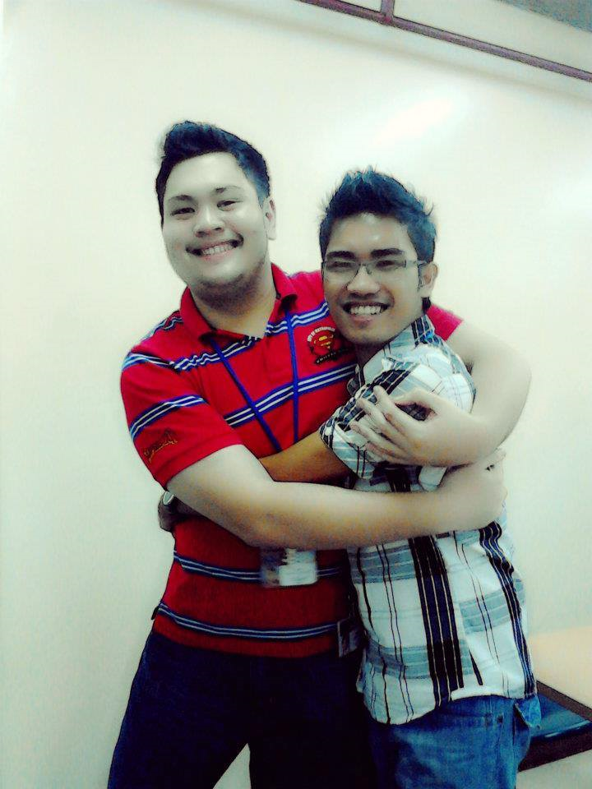
Carlos Daniel B. Nerez
Project Manager
Programmer
Debugger
Documentation

Slide 6
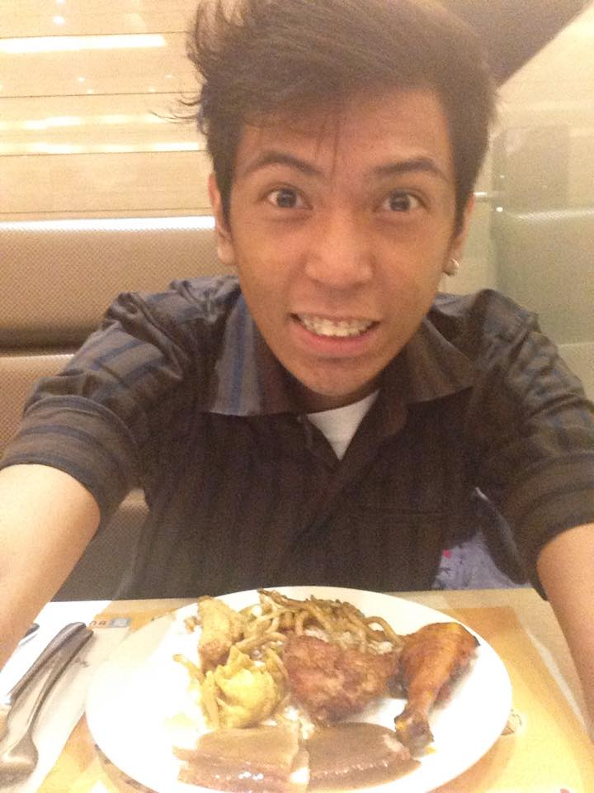
John Michael S. Santos
Web Designer
Mobile Designer
Programmer
Debugger

Slide 7
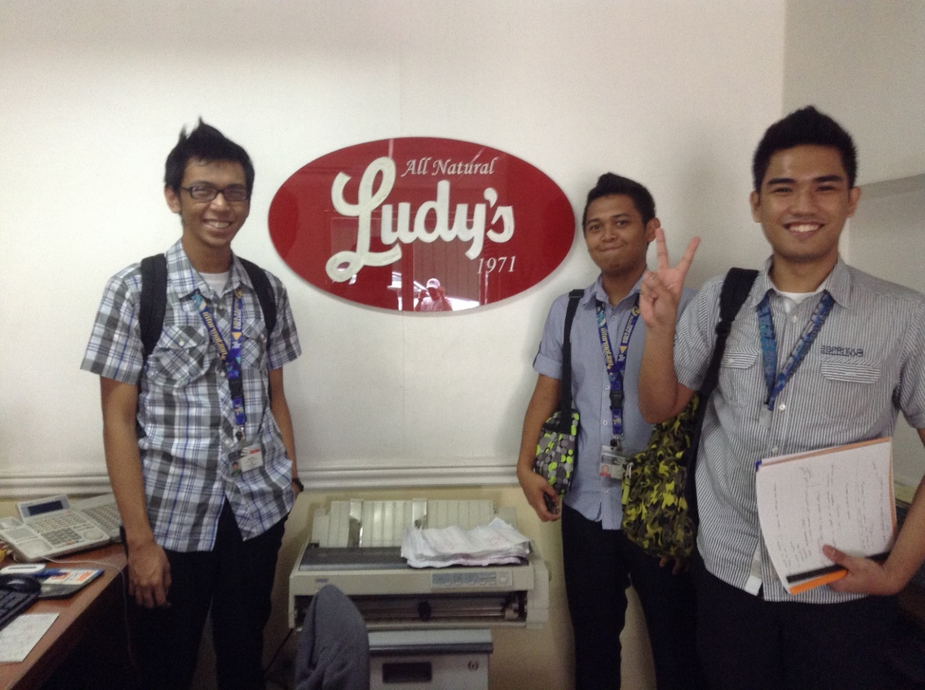
About the Client

Slide 8
Background of the Client
Rodzon Marketing Corporation is a private company that was founded in 1977.
It specializes in wholesale and general merchandise field in the market.
Located at Barangay 65, Lakandula st, Pasay City, Philippines, the company is known for their flagship product, Ludy’s peanut butter.
Now, with almost 37 years of experience in the industry, RMC has acquired and introduced more and more products to its customers.
Currently, their line of products include: Ludy’s peanut butter, Sourcere’s Fluffy and Melo marshmallow snacks and other varieties of processed - food products.

Slide 9
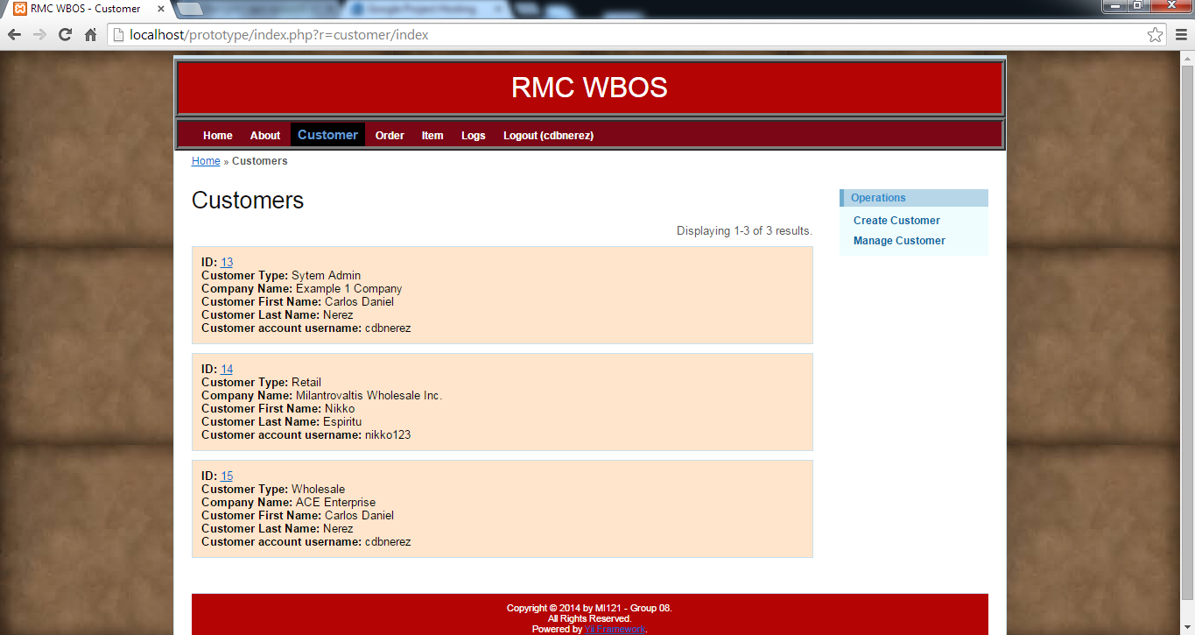
About the Project

Slide 10
Project Background and Description
RMC lacks I.T. solutions and wants to implement different systems that could make their work – done (process) easier.
One field that is in need of I.T. solution(s) is the manual ordering process.
The manual ordering process is inefficient given today’s available technology.

Slide 11
The Existing Process
The manual process includes:
Creating the customer background
Creating an order entry
Filling up the order entry with list items
Creating the payment and delivery information of that particular order entry for that particular customer.

Slide 12
The Proposed Solution
To make work efficient and fast on this field, RMC wanted to have an web – based ordering system.
This system would make the ordering process easier, faster and effortless.

Slide 13
The Tools used for the Project
git
Google Code
Google Developers
Tortoise Git
Yii Framework

Slide 14
The Tools used for the Project
Yii (Framework)
MySQL Workbench (Database Design)
Xampp (Local Server; “localhost”)
PhpMyAdmin
Version control (Git and Tortoise git)
Ubuntu Linus server (Cloud hosting)
code.google.com (Google Code as the project’s repository)

Slide 15
What is Yii?
Is an acronym for "Yes It Is!"
Yii is a high-performance, component-based framework for developing large-scale Web applications rapidly.
It is written in PHP
Enables maximum reusability in Web programming
Significantly accelerates a Web application’s development process.
Source: http://www.yiiframework.com/doc/guide/1.1/en/quickstart.what-is-yii

Slide 16
Yii

Slide 17
What is Version Control?
It is the management of changes to documents, computer programs, large web sites, and other collections of information.
Changes are usually identified by a number or letter code, termed the “revision number”, “revision level”, or simply “revision”.
In SYSADD1, we were introduced to Git and Tortoise Git.
These are the programs used to update the system from time to time.
Functions include: Commit, push and pull.
Source: http://en.wikipedia.org/wiki/Revision_control

Slide 18
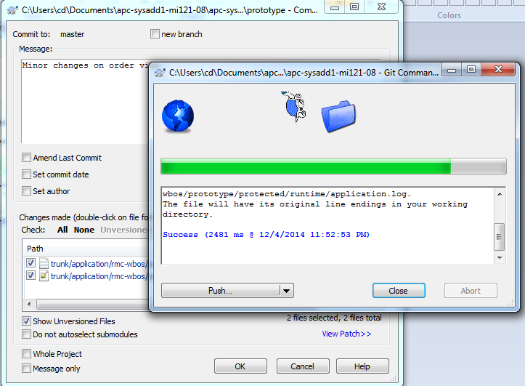
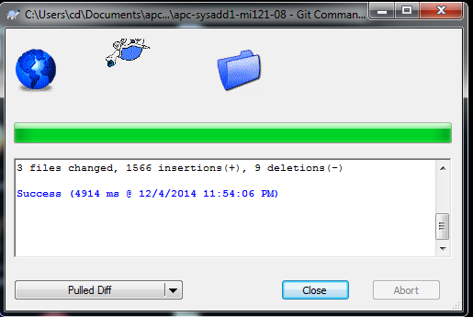
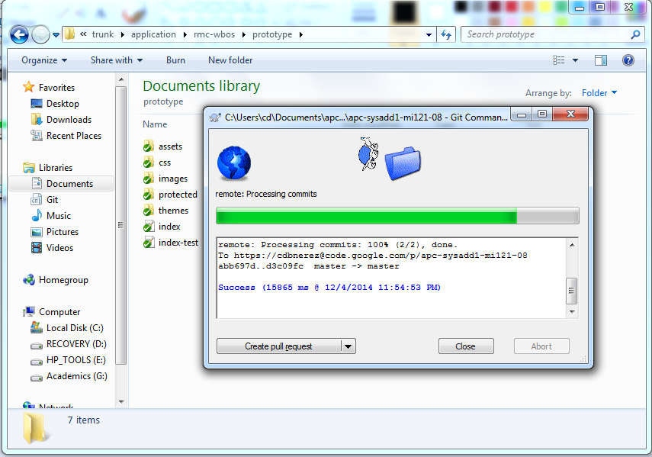
Git and Totoise Git

Slide 19
What is code.google.com?
Google Developers (previously Google Code) is Google's site for software development tools, application programming interfaces (APIs), and technical resources.
It’s the project’s main repository
Useful in checking what changes had been made and who made the changes.
Source: http://en.wikipedia.org/wiki/Google_Developers

Slide 20
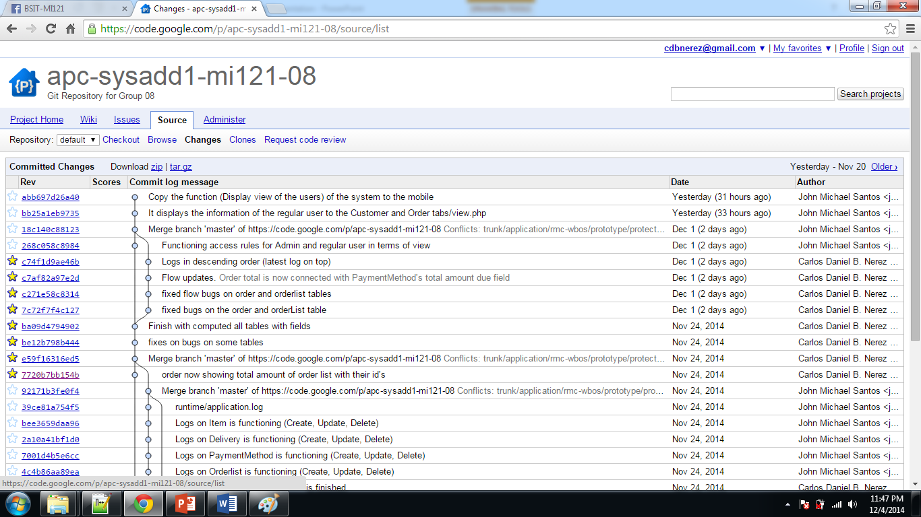
Repository

Slide 21
Creating the Project

Slide 22
How we did it
All members where given a specific task every week
We have one to one and a half weeks to finish a particular task
Each of the member’s work area has clone of the repository
Each update a member made should be committed to the repository
After two weeks, Iterations are held
The project should be hosted before the iteration
Commits are closely monitored by the subject professor
Failure to comply may result to a failing grade

Slide 23
Overview of the application

Slide 24
RMC-WBOS Prototype
About the application:
It is a web – based ordering system
It can be accessed via intranet (client side)
Purpose:
It is designed to make the ordering process easier and faster.
It also lessens time to search for different information about a particular field (e.g. customer information).
Objectives
The system saves time, money and man power
Makes the whole process easier to accomplish

Slide 25
RMC-WBOS Prototype
The system is comprised of 7 modules
Customer –> stores customer information
Order –> stores order and order list information of a particular customer
Order List –> stores a list of items for a specific order form per customer
Item –> stores item information
Payment Method –> stores payment method for a particular order form
Delivery –> stores delivery information of a particular customer
Logs –> stores entry logs for the whole system

Slide 26
RMC-WBOS Prototype
The system has two user types
System Admin
Regular User
For each regular user, there are three subtypes
Wholesale
Retail
Walk - In

Slide 27
RMC-WBOS Prototype
Features included in the system
Calendar Extension
Passing of ID’s
Arithmetic Operations (addition, subtraction, multiplication and division)
Audit Logs/Audit Trail
Mobile Version (mobile CSS)

Slide 28
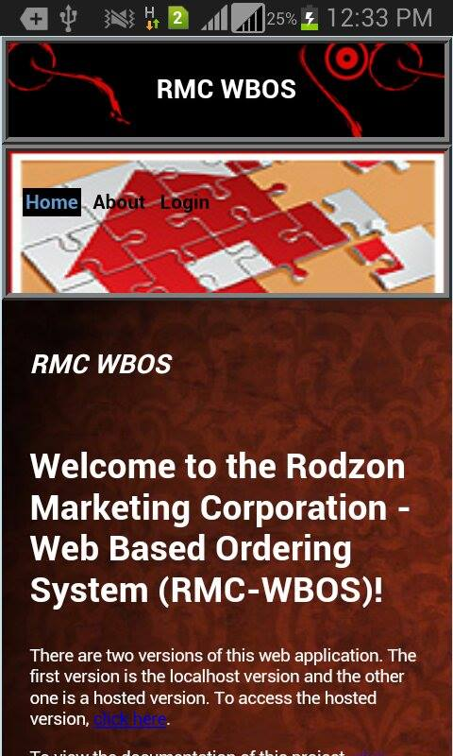
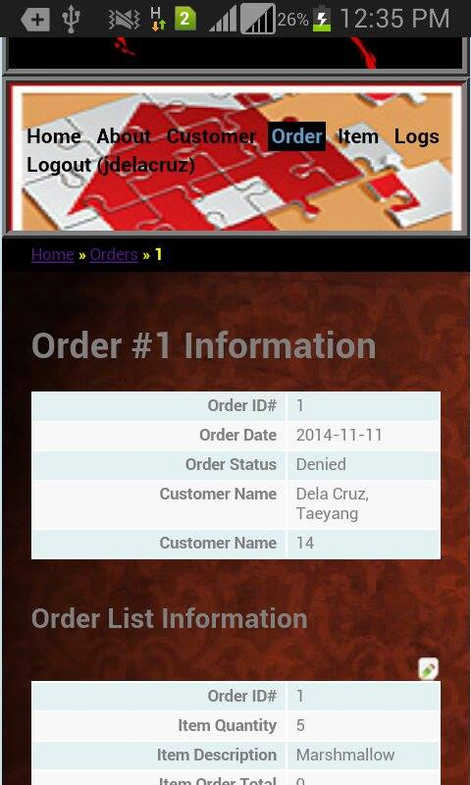
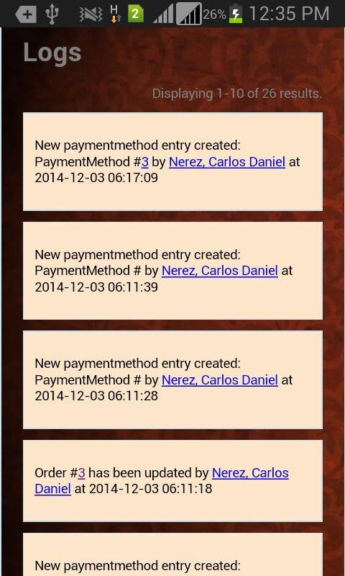
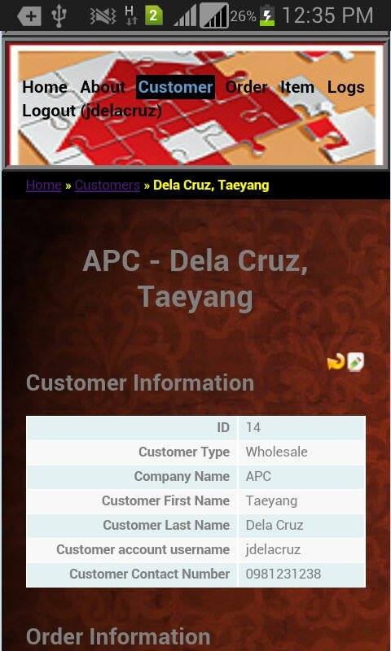
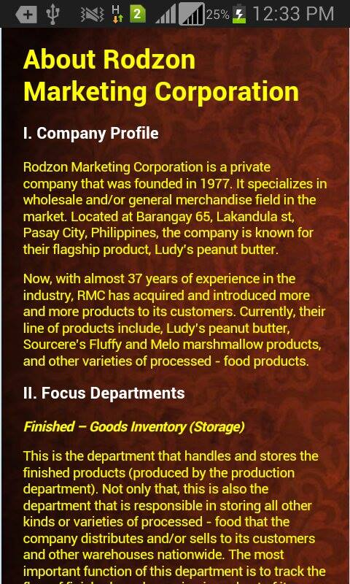
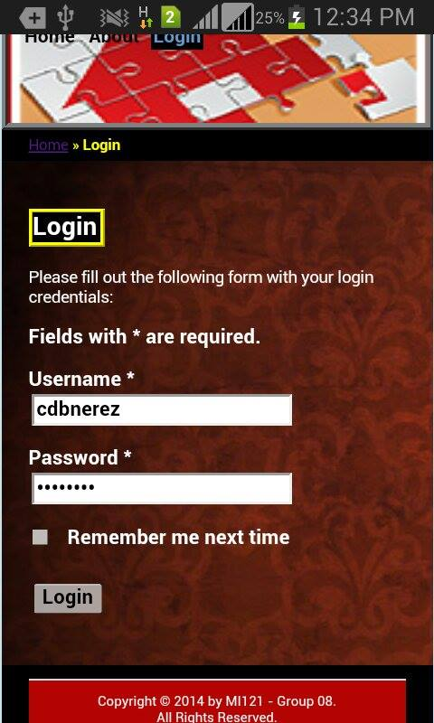
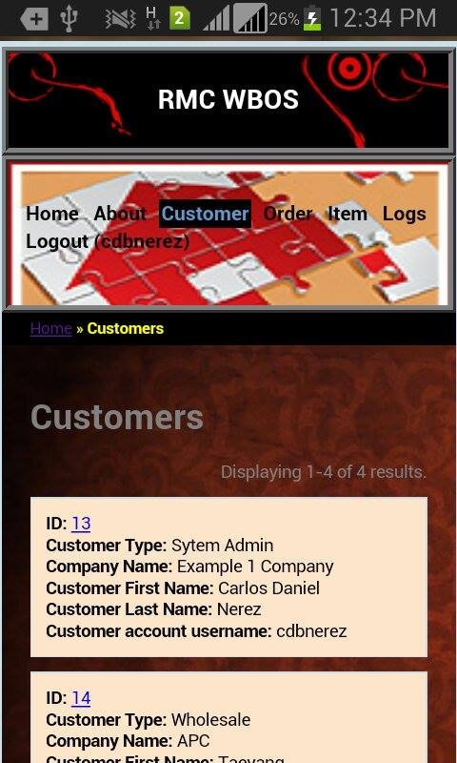
Yii Mobile CSS

Slide 29
Application Walkthrough

Slide 30
Basic Flow (Note: Assuming Item table has data)
Customer
1. System Admin creates customer profile
2. SA clicks “create order” link
Order
3. SA fills out the order form
4. SA clicks “create order list” link
Order List
5. SA selects items to be ordered
6. SA clicks “create payment method” link

Slide 31
RMC-WBOS Prototype
Payment Method
7. SA fills out payment information
8. SA clicks “create delivery” link
Delivery
9. SA fills out delivery information
10. SA is redirected to customer index page

Slide 32
Application Walkthrough (Images)

Slide 33
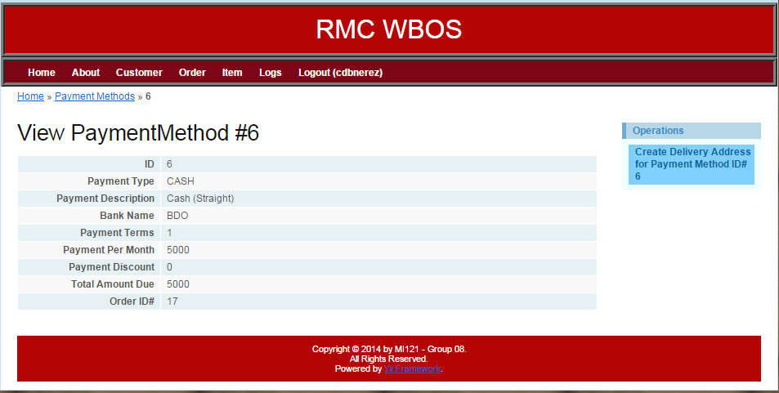
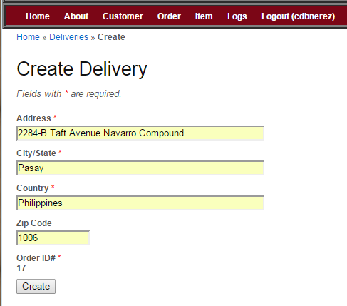
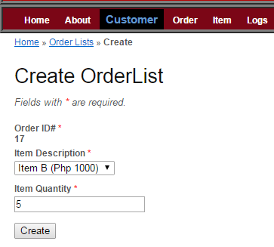
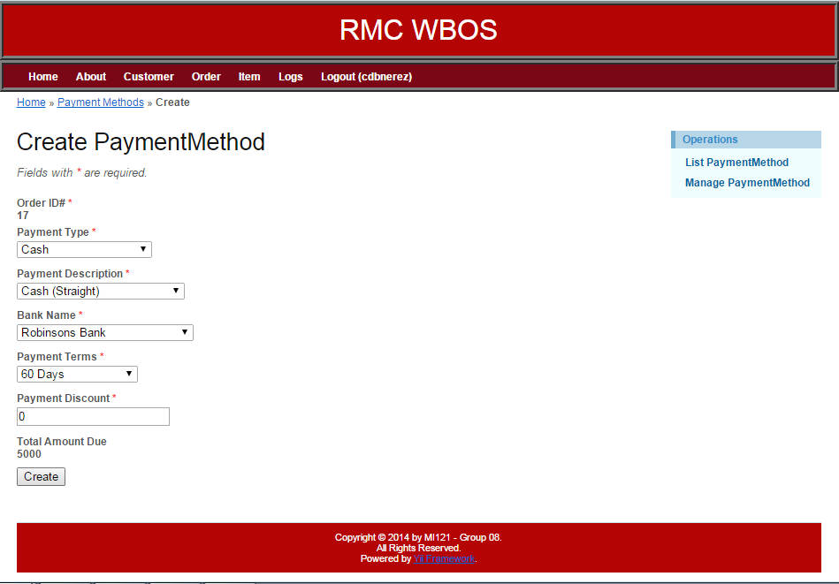
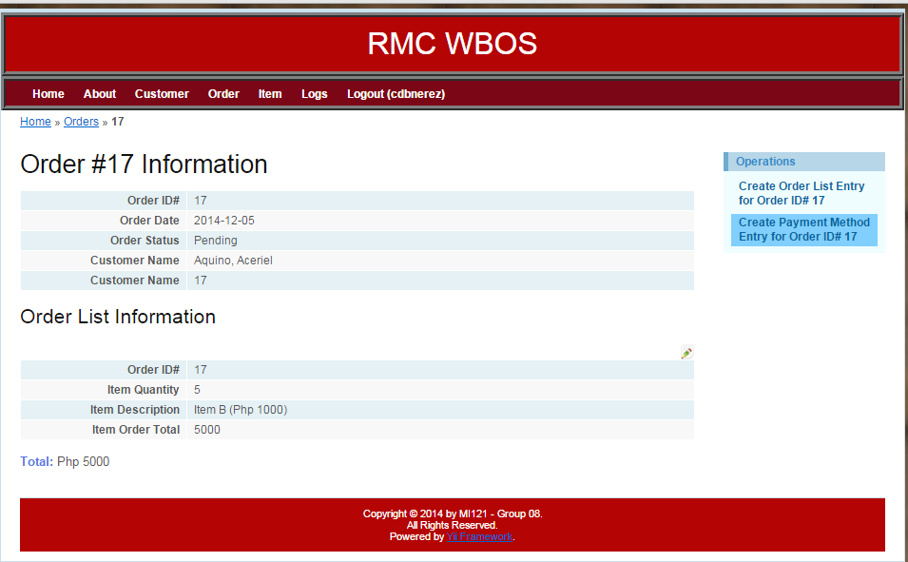
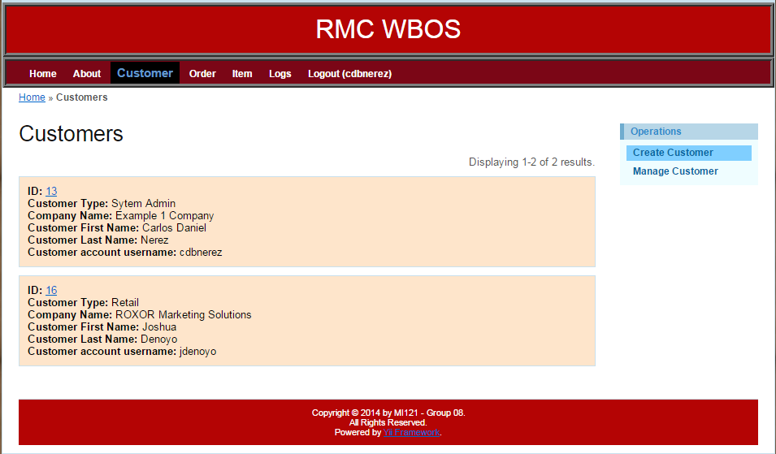
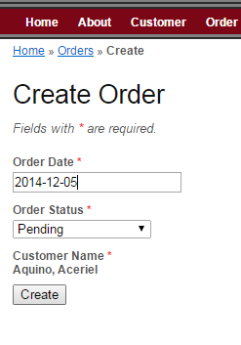
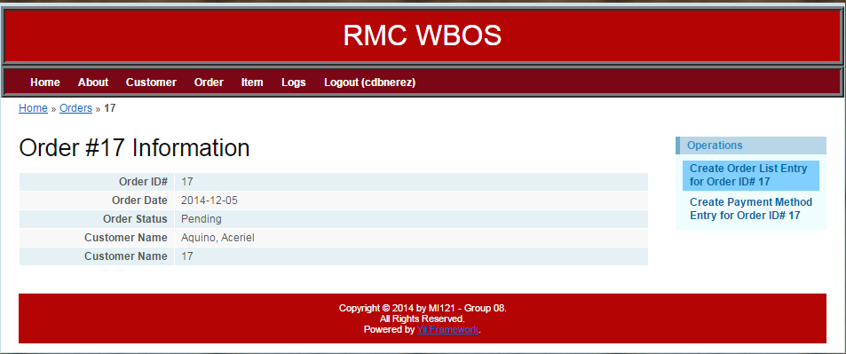
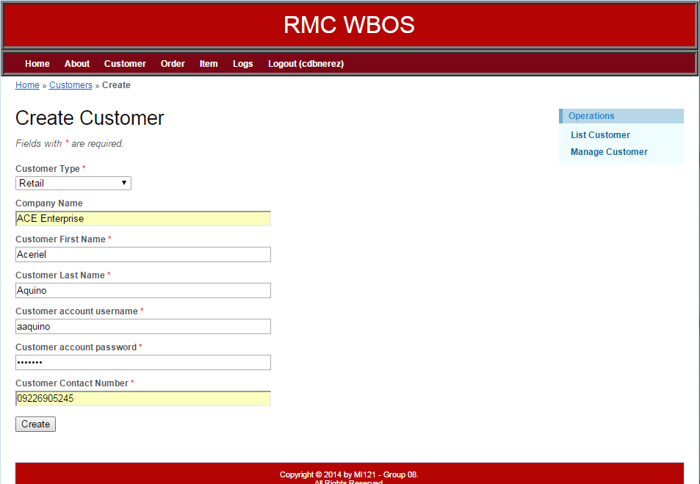
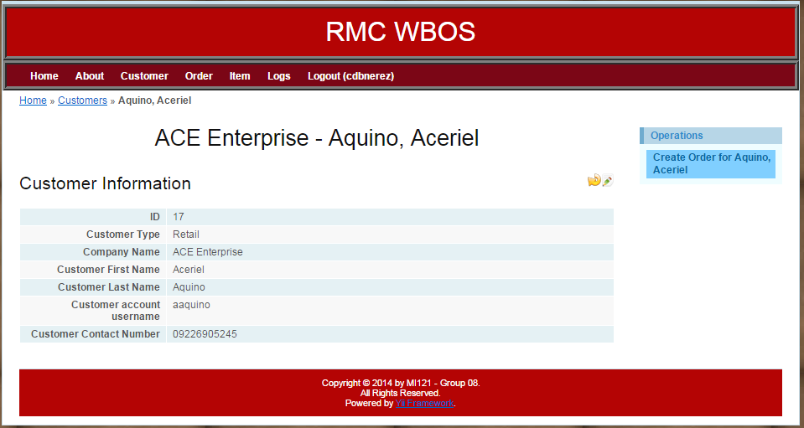
Application Walkthrough

Slide 34
Status of the Application

Slide 35
Status of the Application
Almost 85% complete (based on client and subject requirements)
All modules are completed and fully functional
Additional functionalities may be added in the future
CSS needs improvements
We did not implement bootstrap
We lack JavaScript codes to further enhance the system’s features
We did not implement many extensions
We did not implement any themes

Slide 36
Status of the Application (Client)

Slide 37
Status of the Application (Client)
The client stated that unfortunately, they will not implement the system on their main office.
Though, it would not be implemented, they wanted our prototype system to have similarities with their soon – to - be implemented ERP system.
They are keen and hands - on the development of the system (10 month partnership).

Slide 38
Status of the Application (Client)
Present the version 4 of the system to the client
Give the source code to the client
Update them on what happened to the project’s defense

Slide 39
Live Demo

Slide 40
Questions and Answers

Slide 41
Thank You and Good Day!

